Slide 1
projects 2.0.0
September 13, 2019
Created by Nik Krieger
and Jarrod Dalton

Slide 2

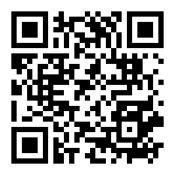
Nikolas I Krieger, MA, MS
Data Scientist
github.com/NikKrieger/projects

Slide 3

Jarrod E Dalton, PhD
Assistant Staff, Department of Quantitative Health Sciences
github.com/NikKrieger/projects

Slide 4
projects 2.0.0
September 13, 2019
Created by Nik Krieger
and Jarrod Dalton
github.com/NikKrieger/projects

Slide 5
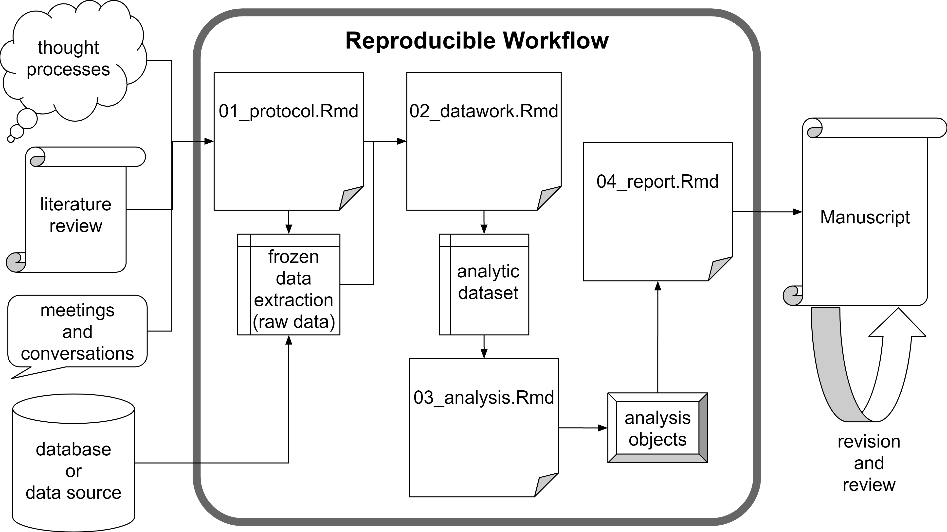

Slide 6
The projects package is:
A tool to aid project organization and reproducibility…
...for R users…
...who manage multiple projects…
...and especially those who write academic manuscripts.

Slide 7
Key features:
Automated, centralized project folder generation
Customizable project folder templates
Simple project (and author) database
Preformatted title pages (for R Markdown)
Seamless RStudio integration

Slide 8
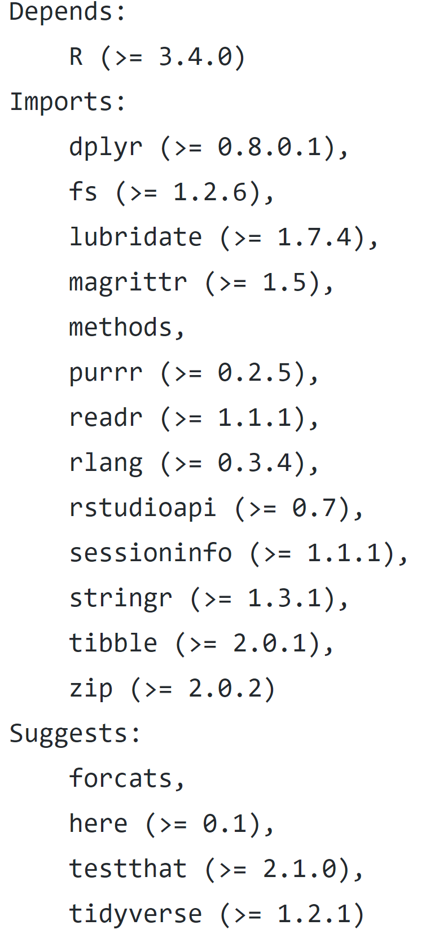
Dependencies
Also:
R needs read/write access to a (shared) folder
RStudio required for some convenience functions

Slide 9
Setup
install.packages("projects")
# remotes::install_github("NikKrieger/projects")
library(projects)

Slide 10
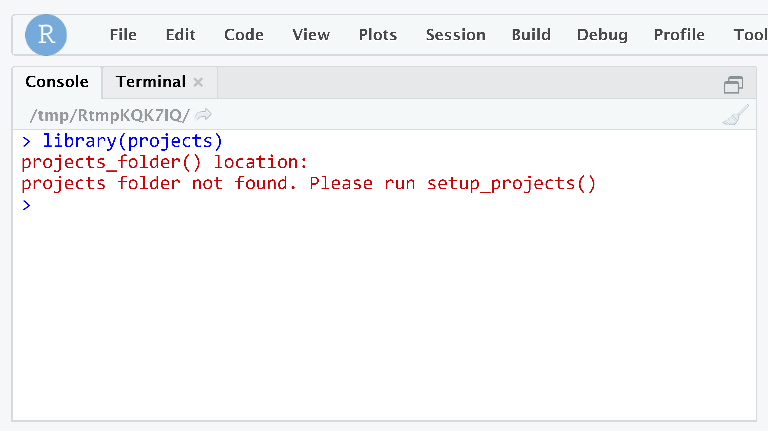

Slide 11
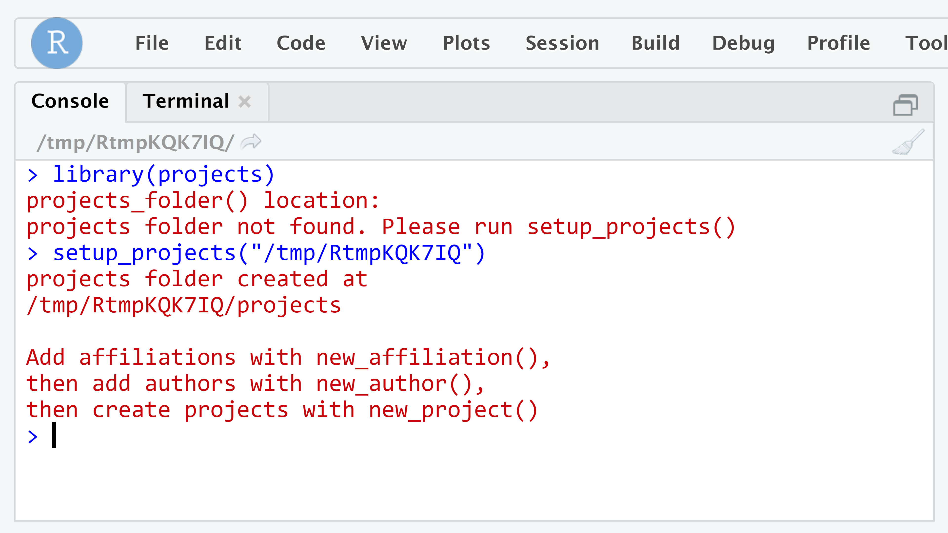

Slide 12
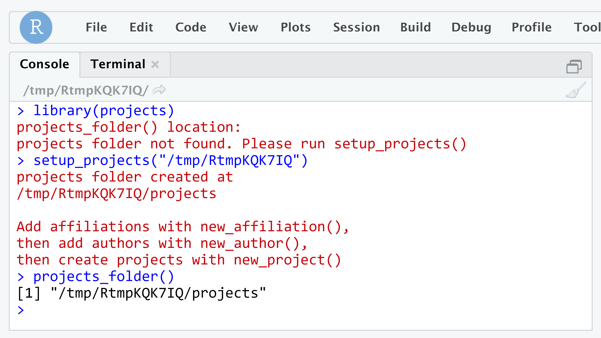

Slide 13
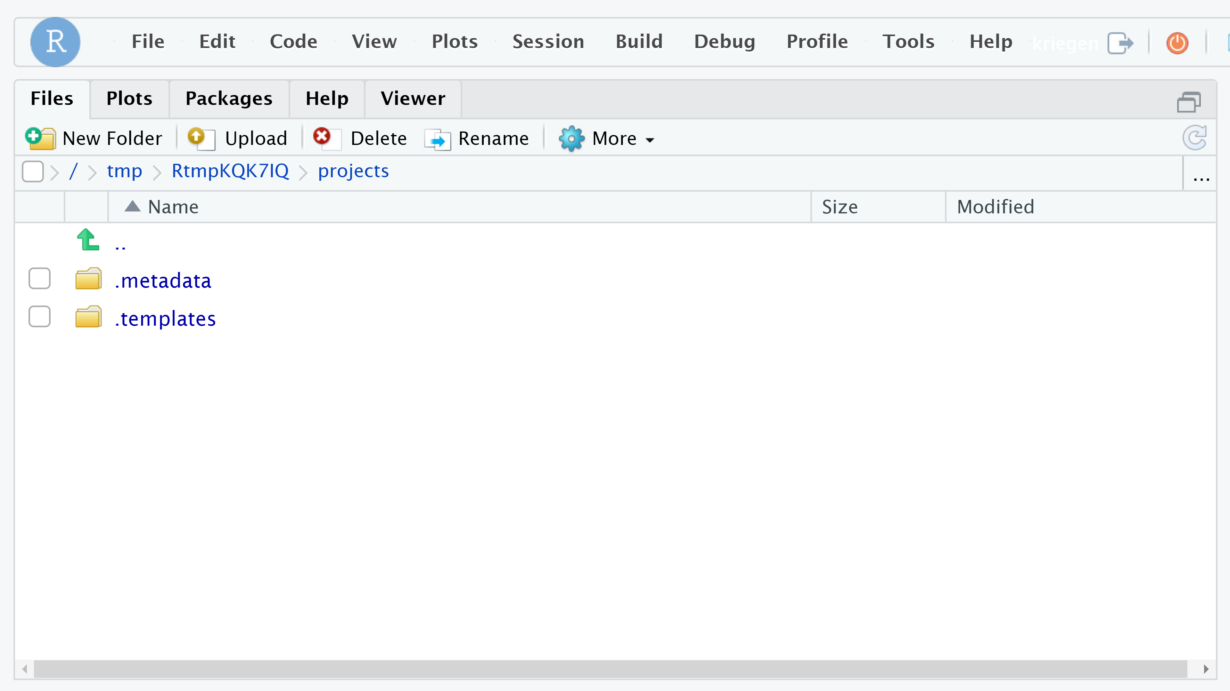

Slide 14
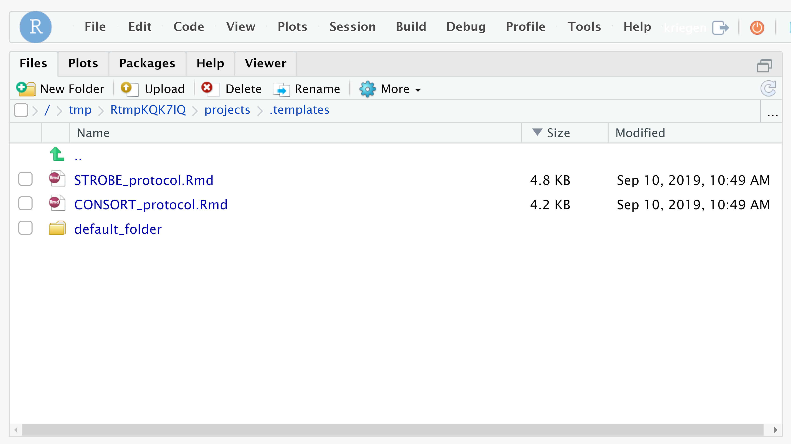

Slide 15
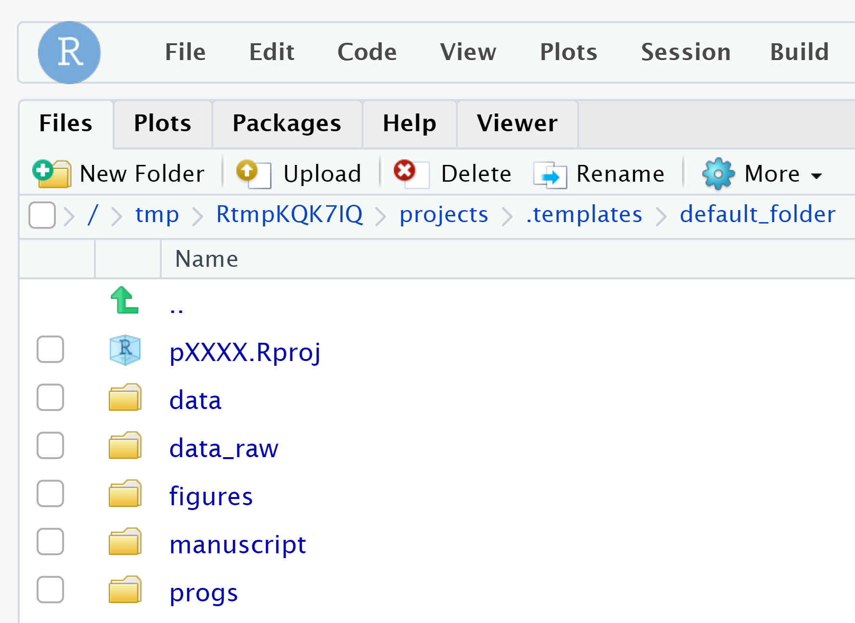
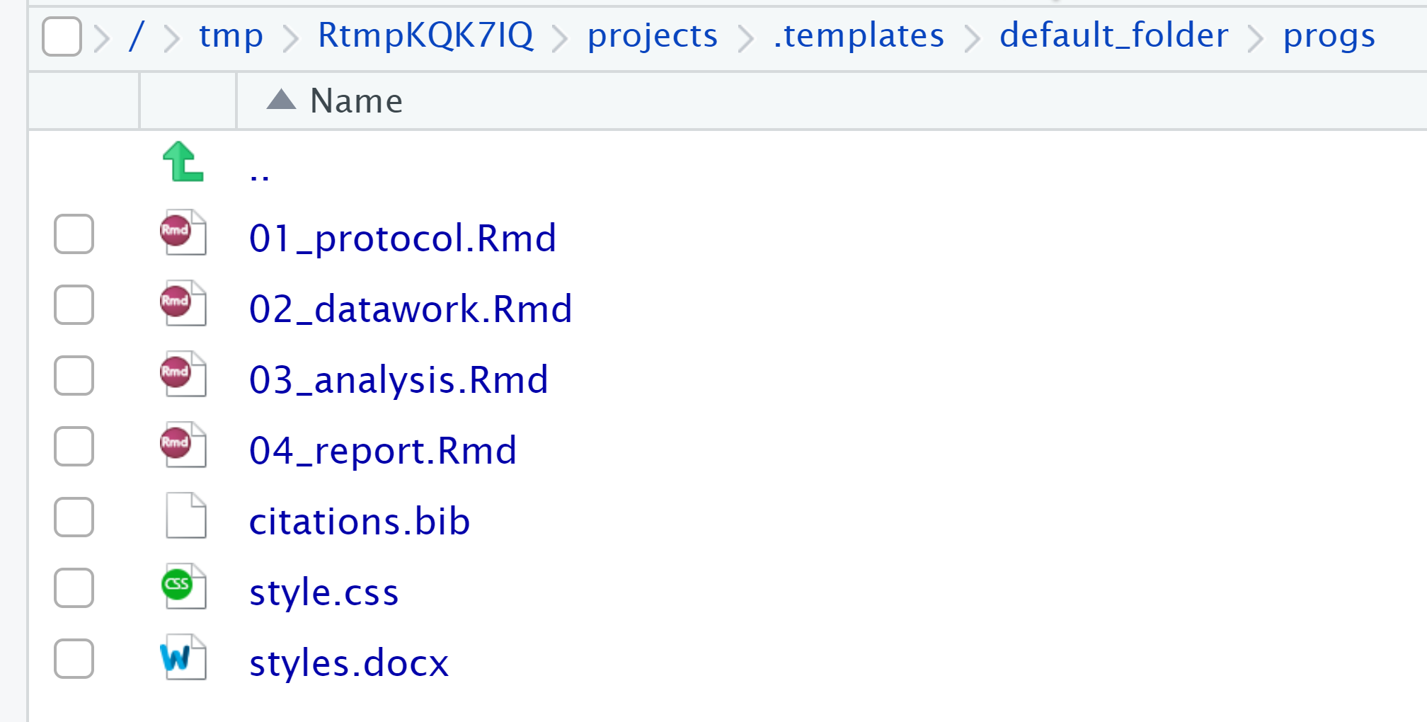

Slide 16
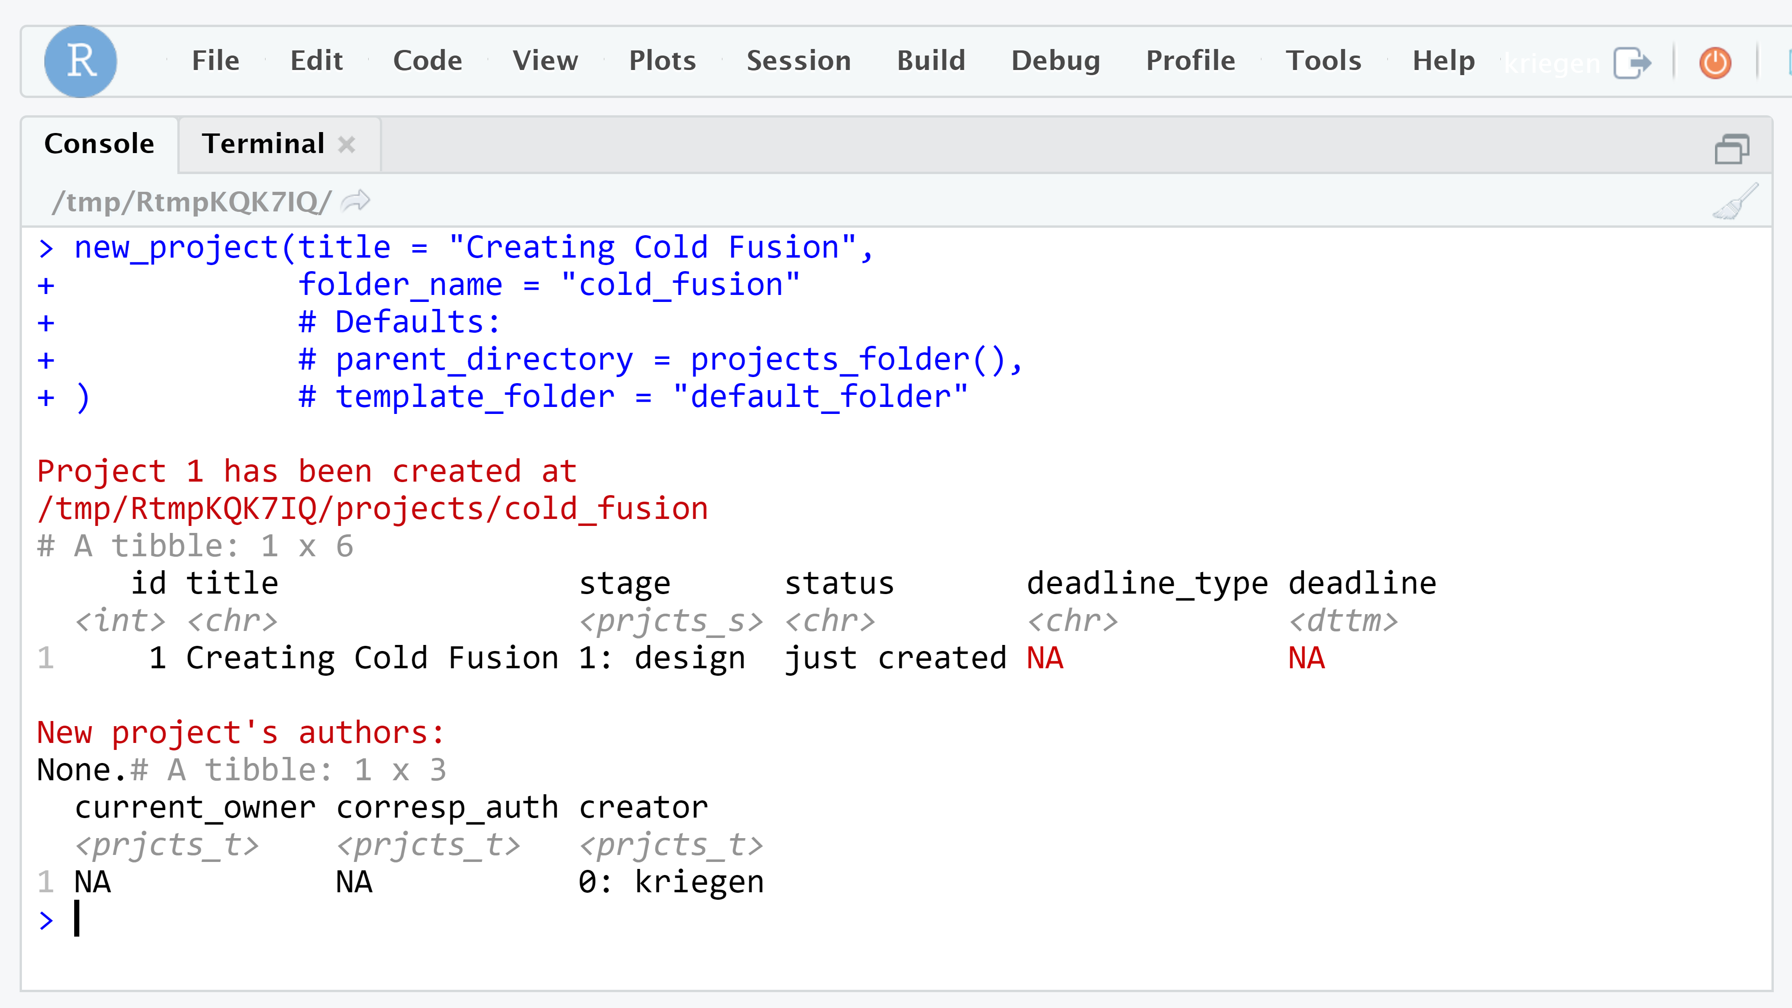

Slide 17
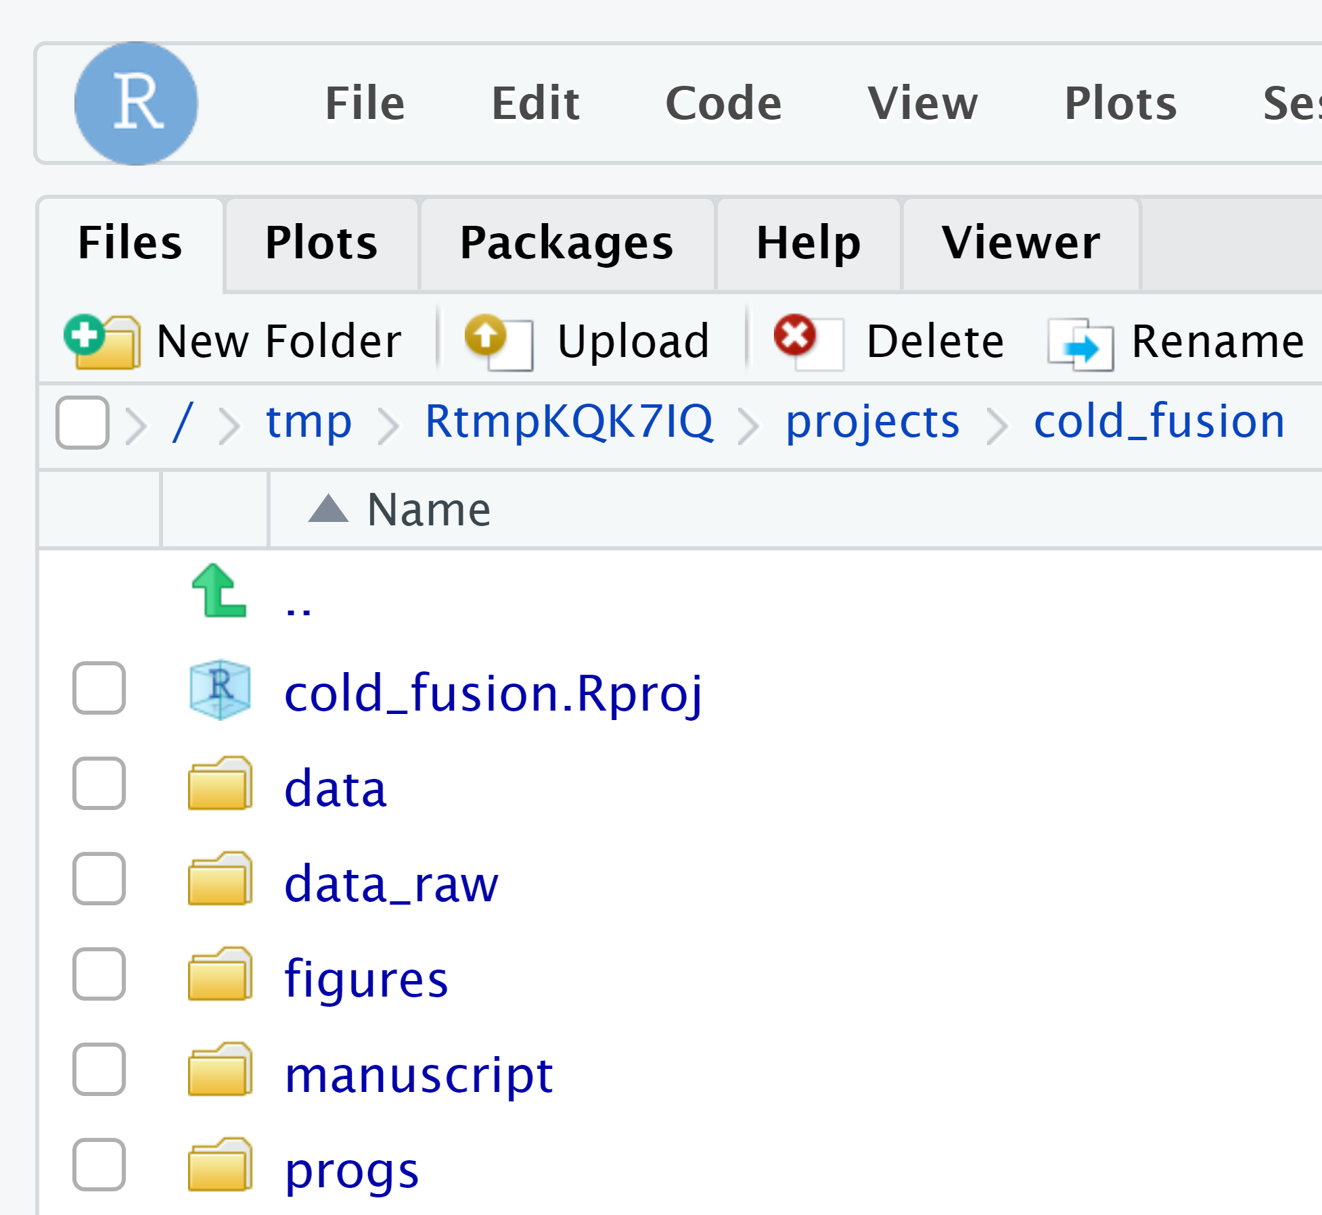
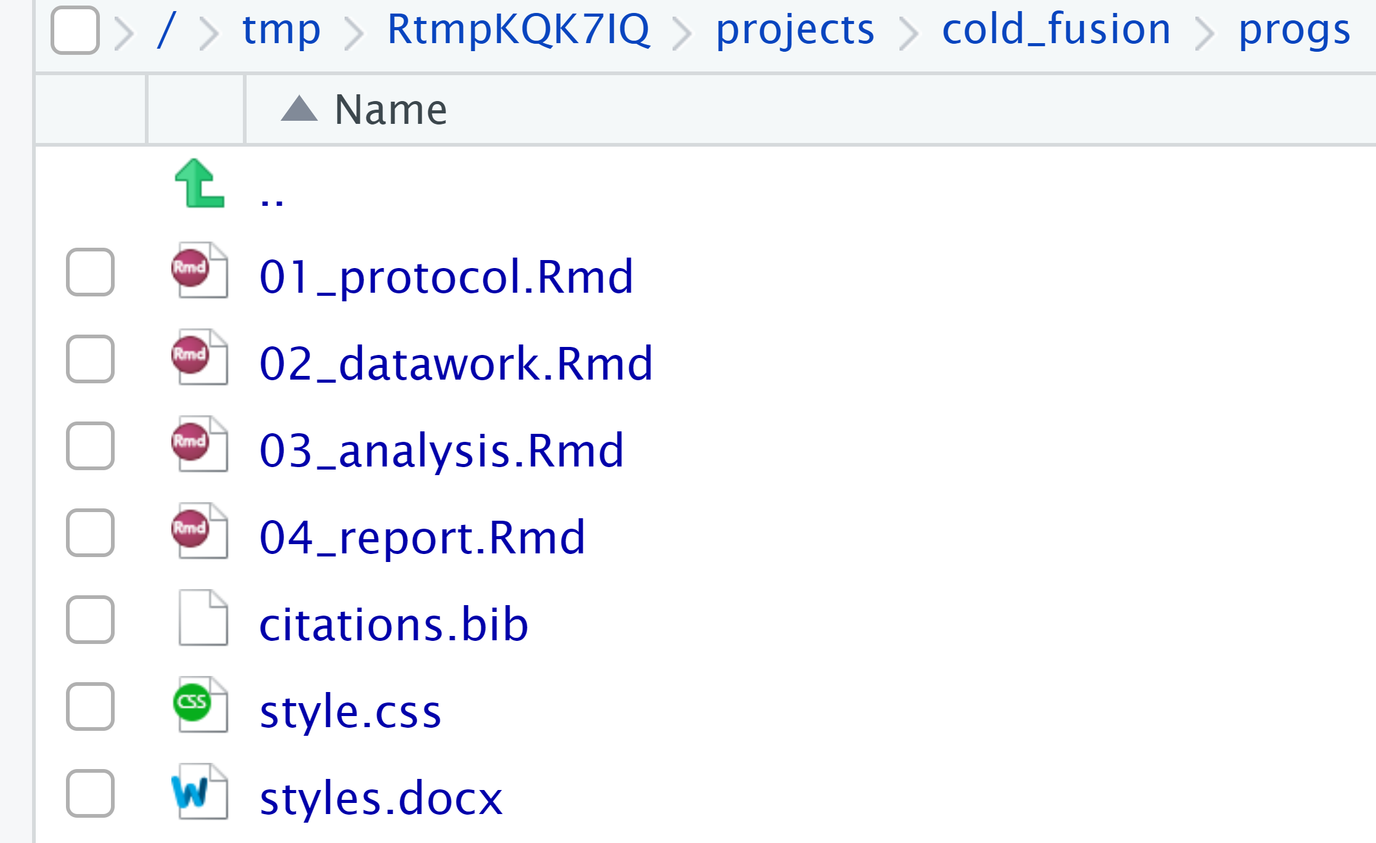

Slide 18
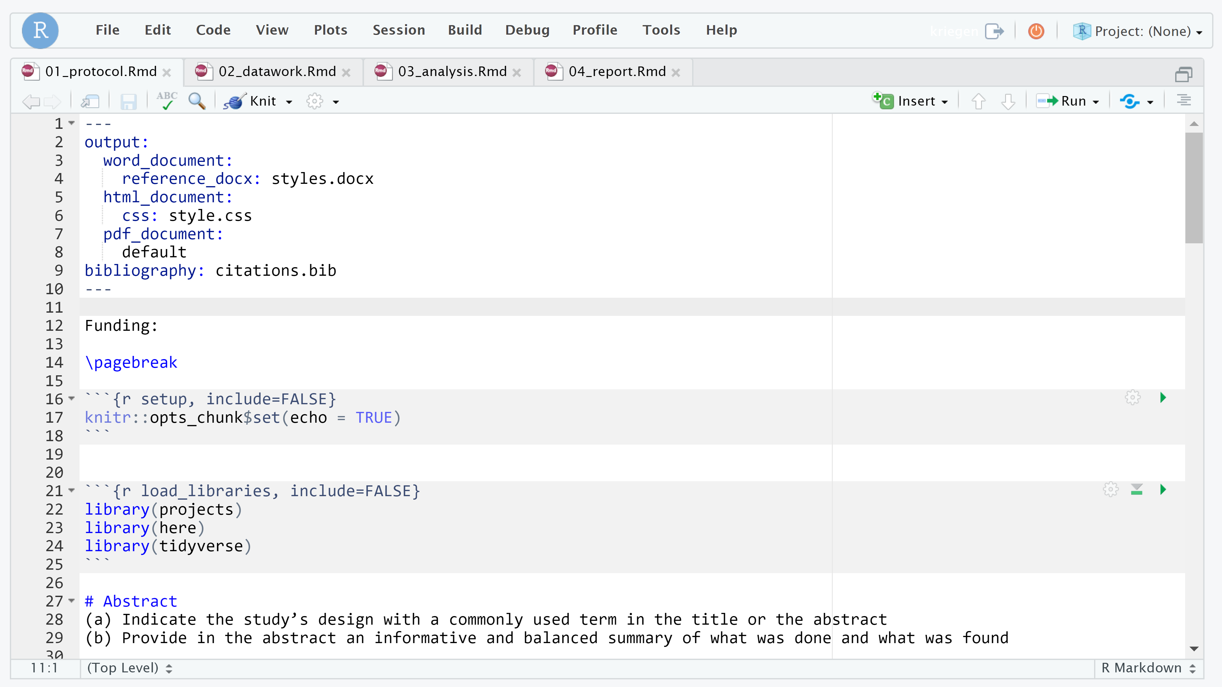

Slide 19
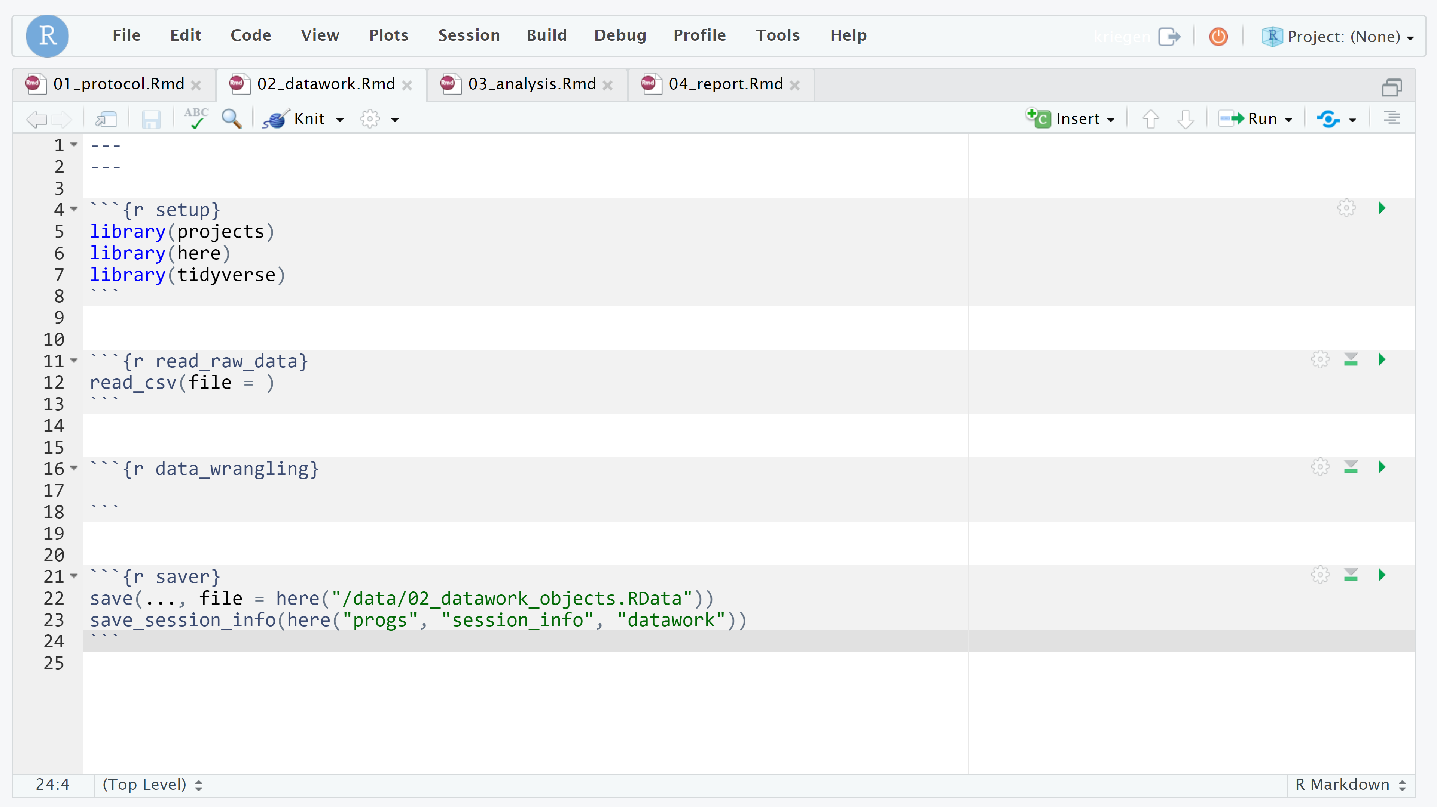

Slide 20
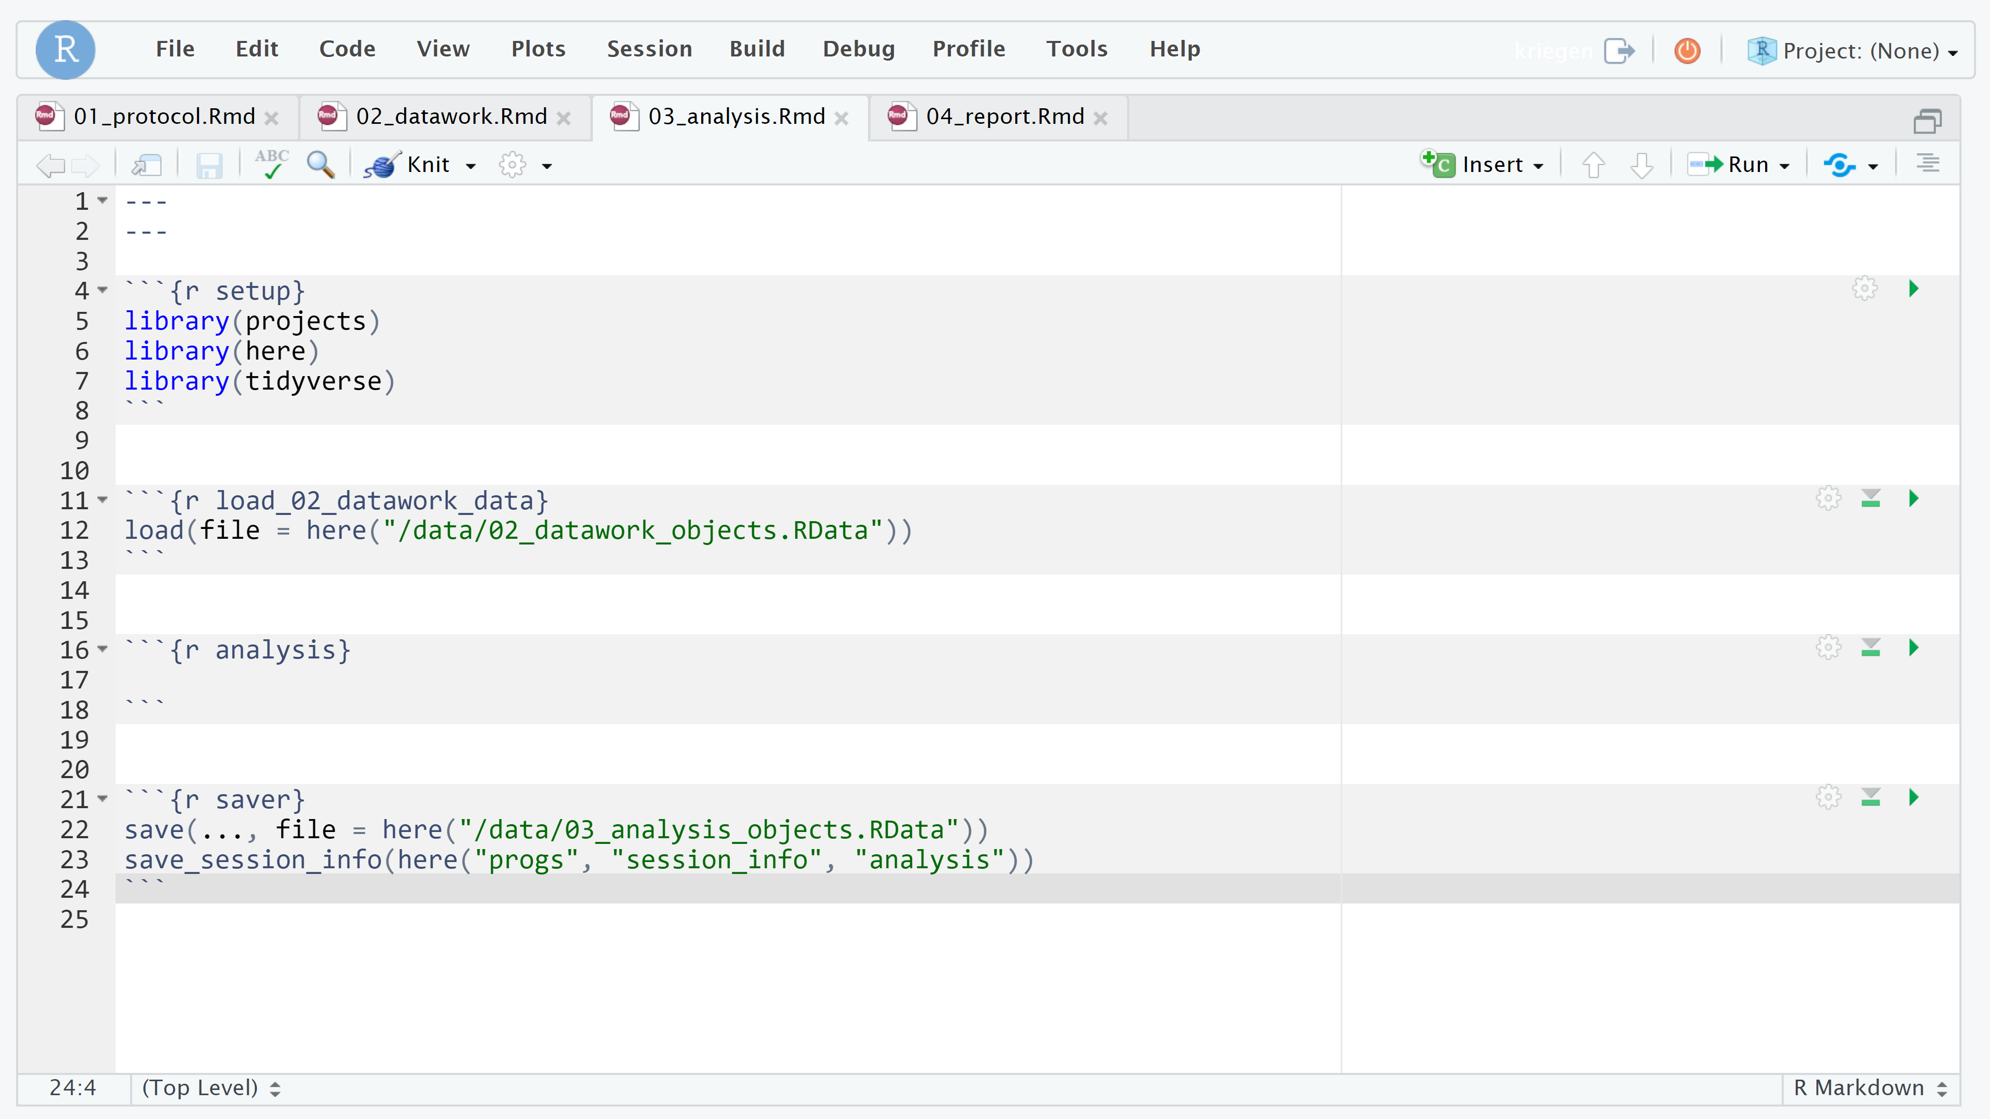

Slide 21
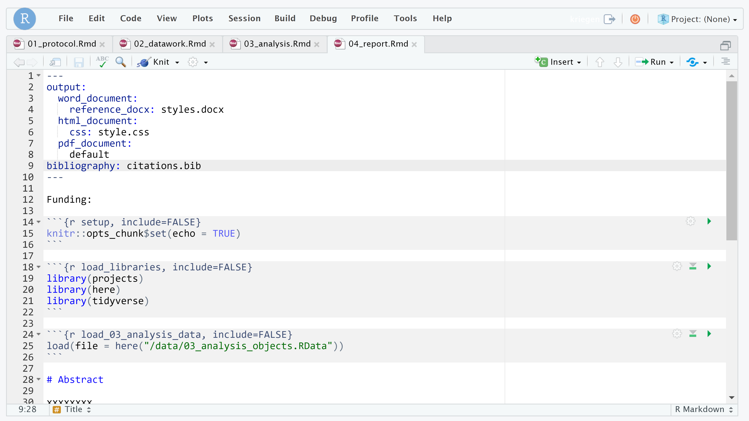

Slide 22
Where’s the title page?
Create authors with new_author()
Add authors to a project
authors argument in new_project()
or add them later with edit_project()
Run header() to obtain title page text

Slide 23
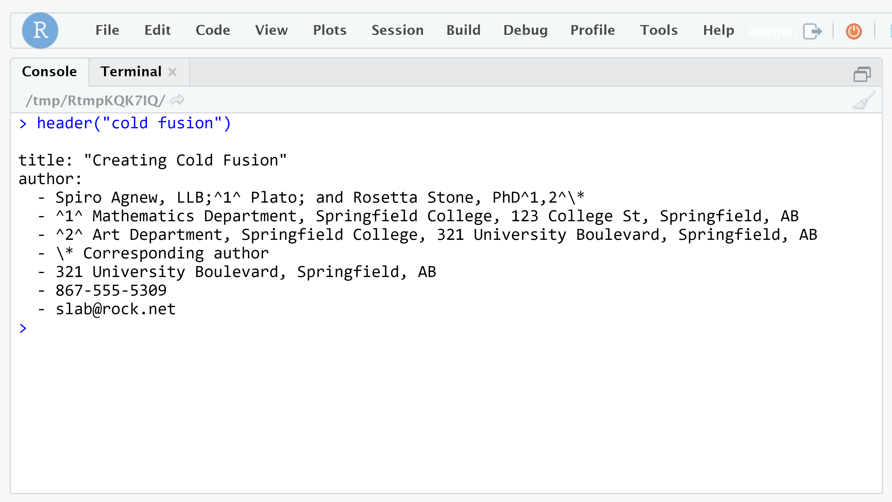

Slide 24
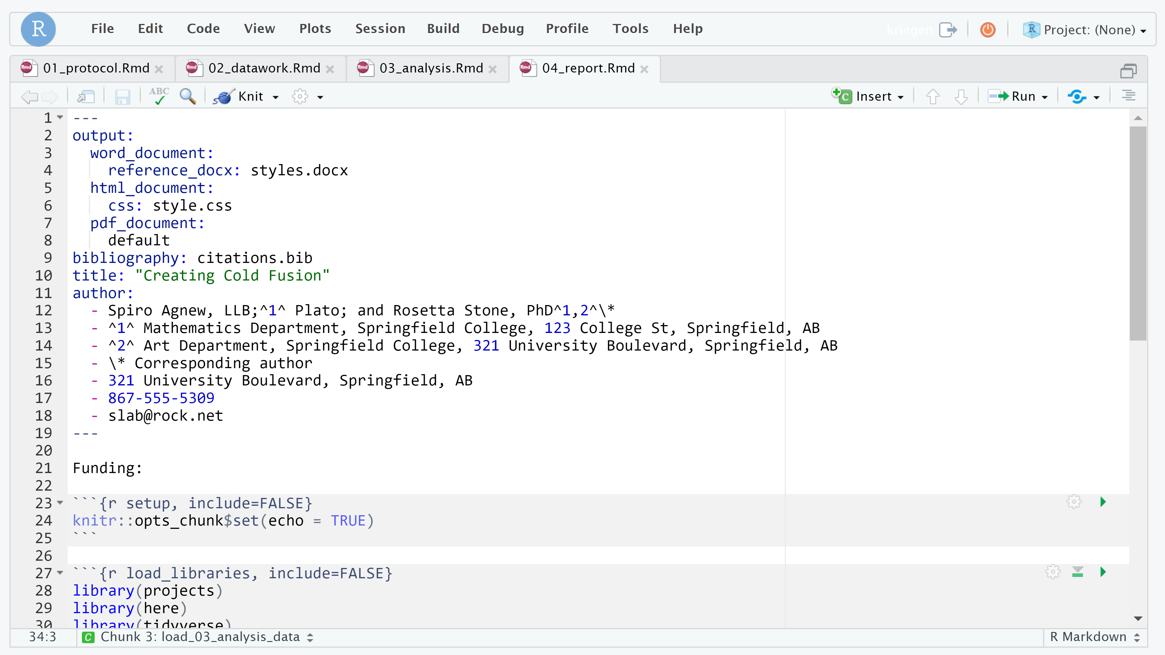

Slide 25
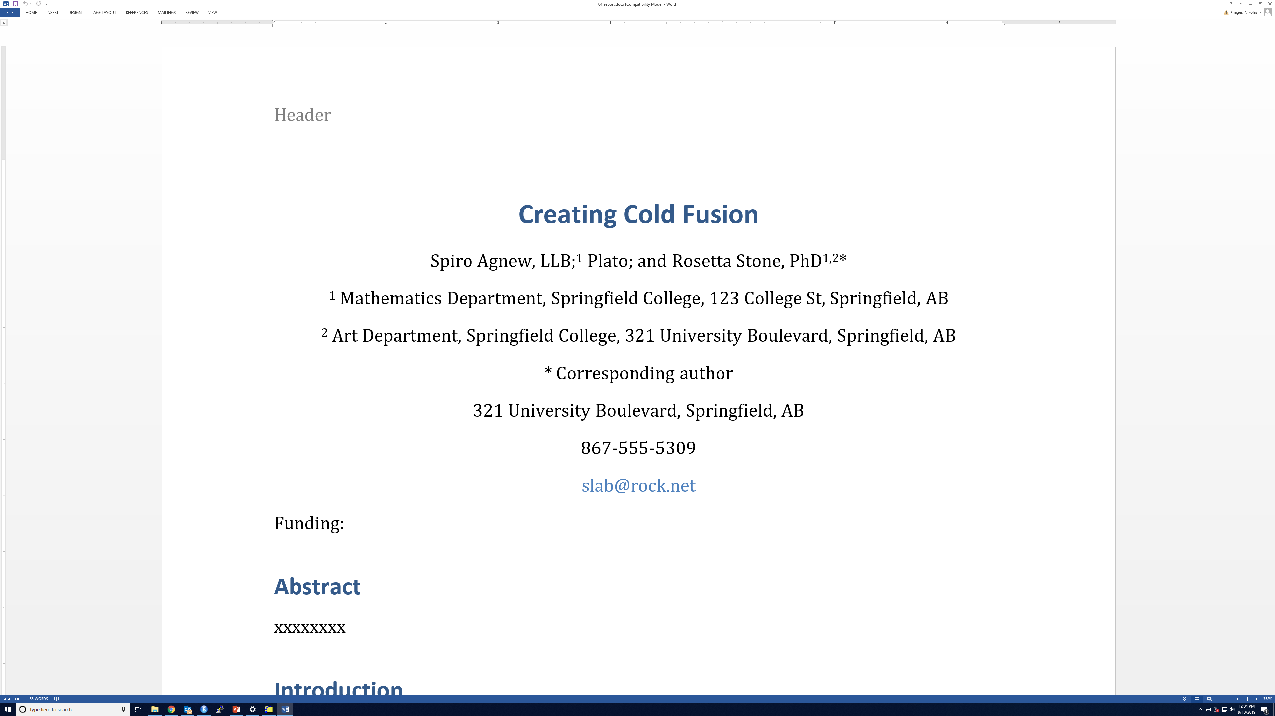

Slide 26
File management functions
move_project()
rename_folder()
copy_project()
archive_project()
delete_project()

Slide 27
Accessing the projects() database
projects()
ideas()
manuscripts()
authors()
affiliations()

Slide 28
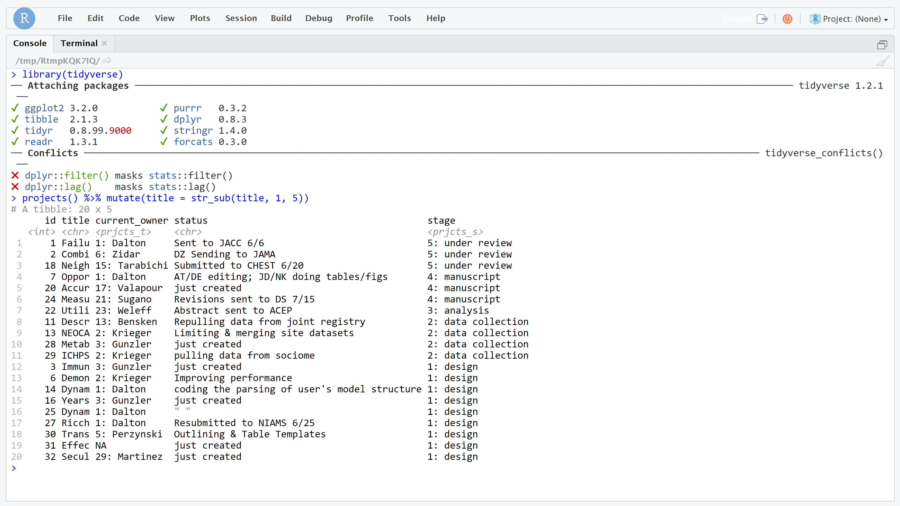

Slide 29
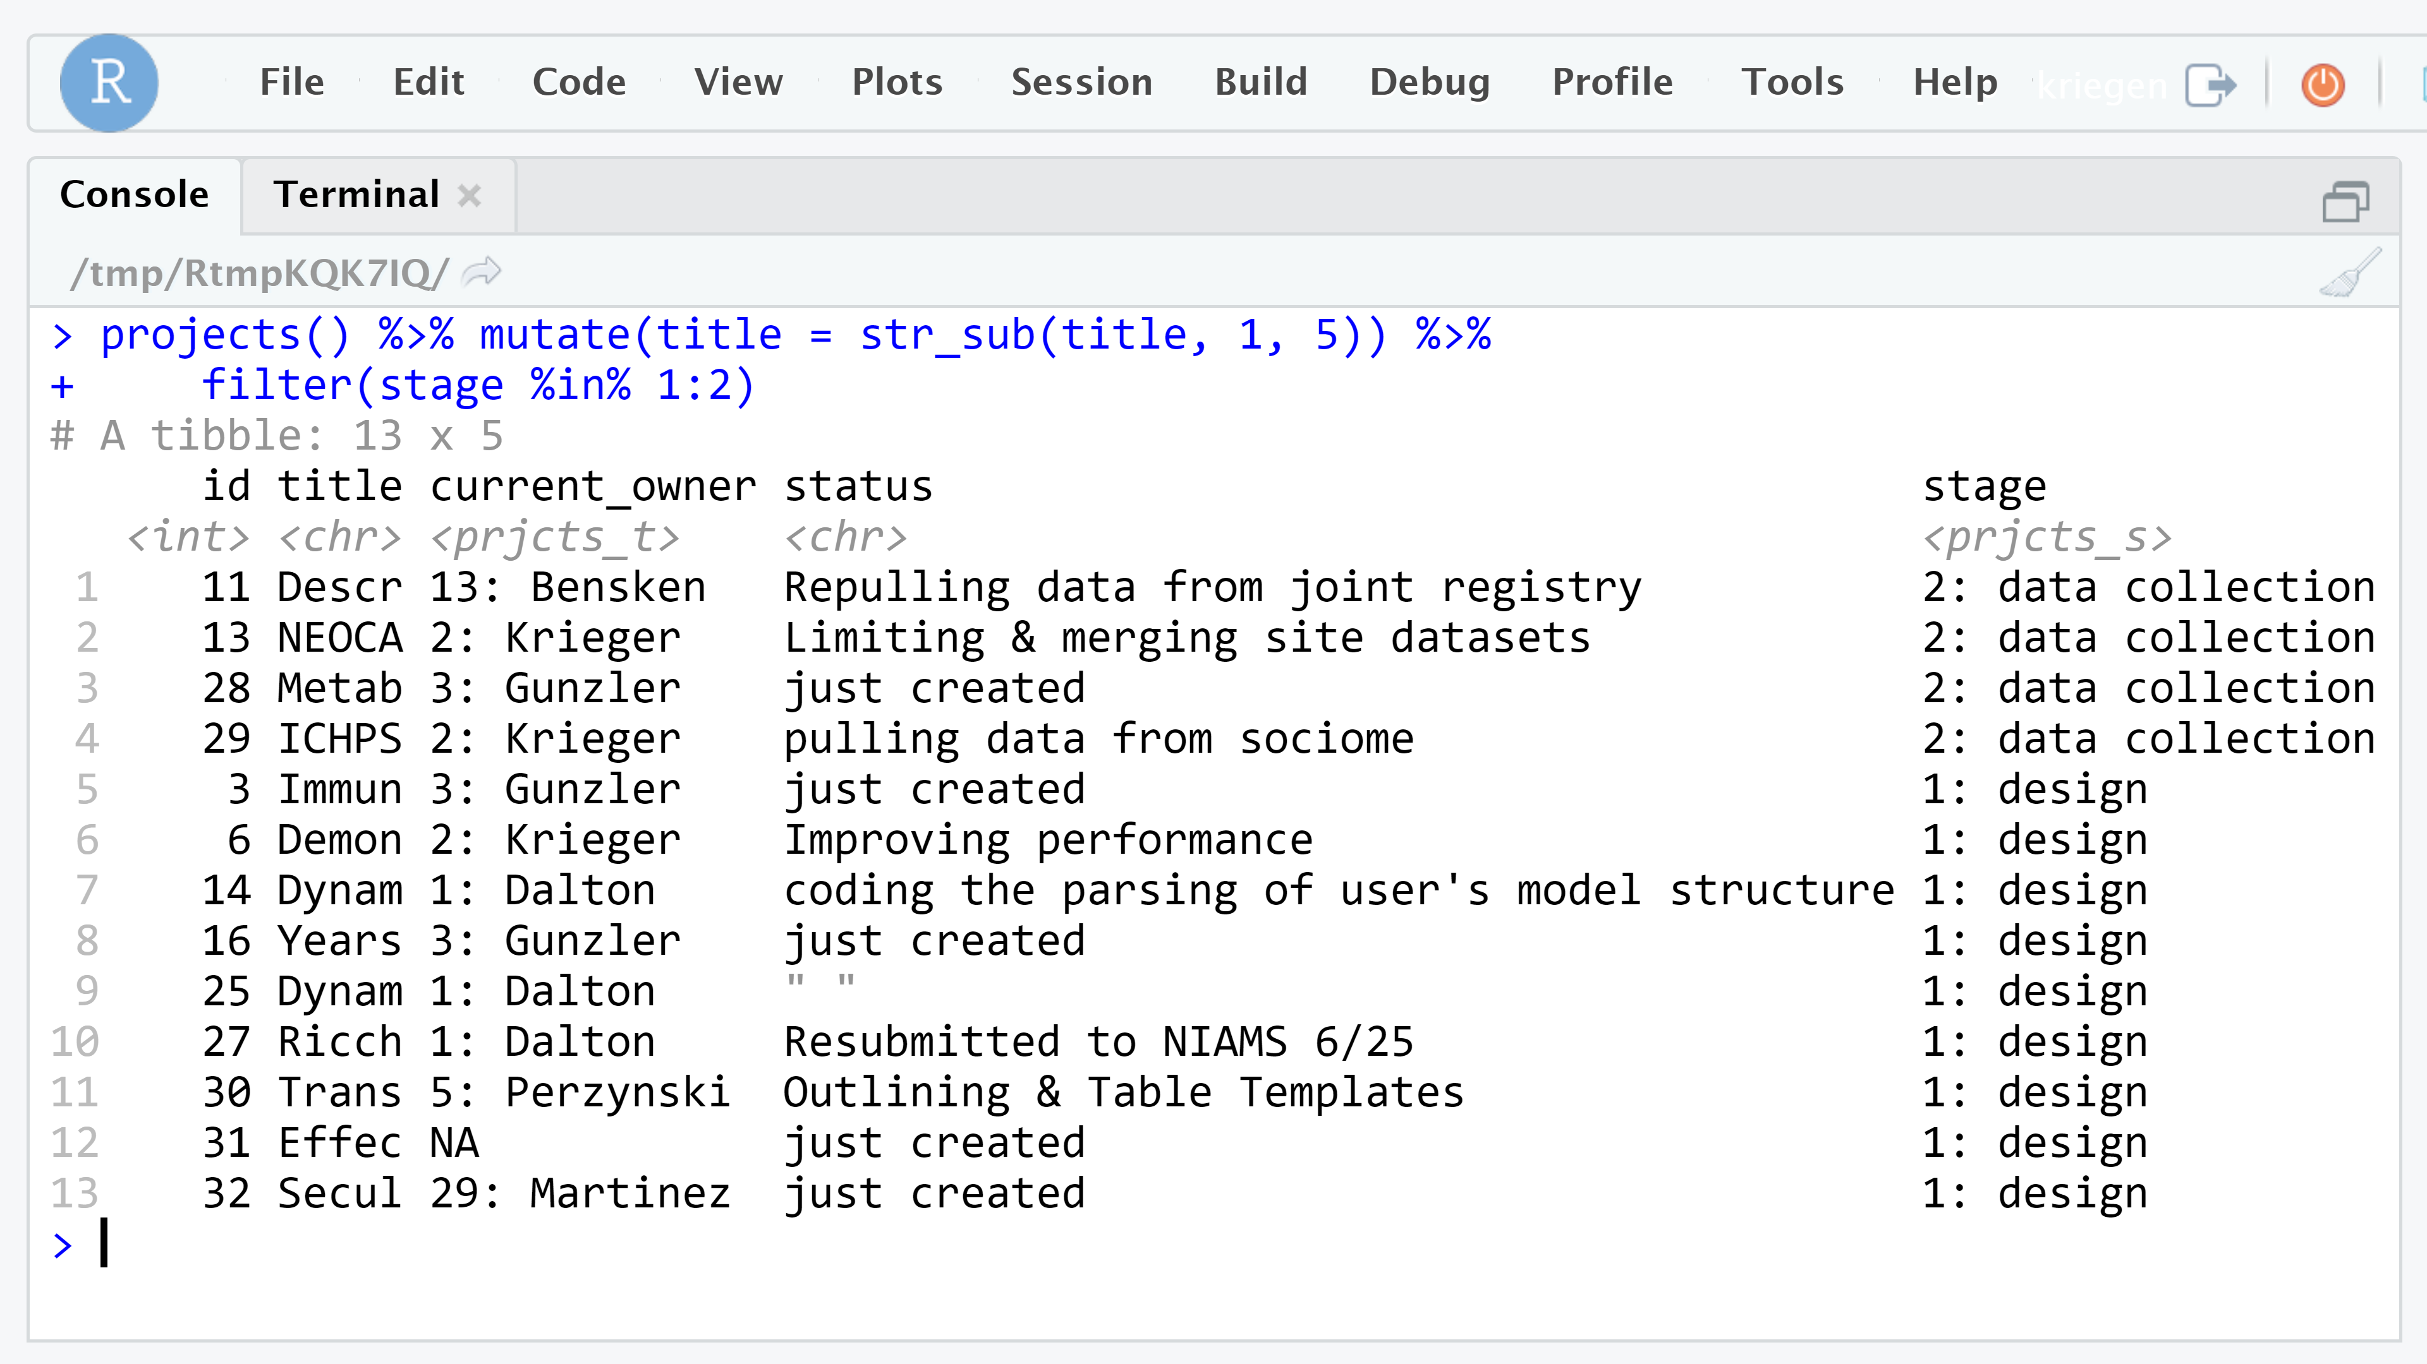

Slide 30
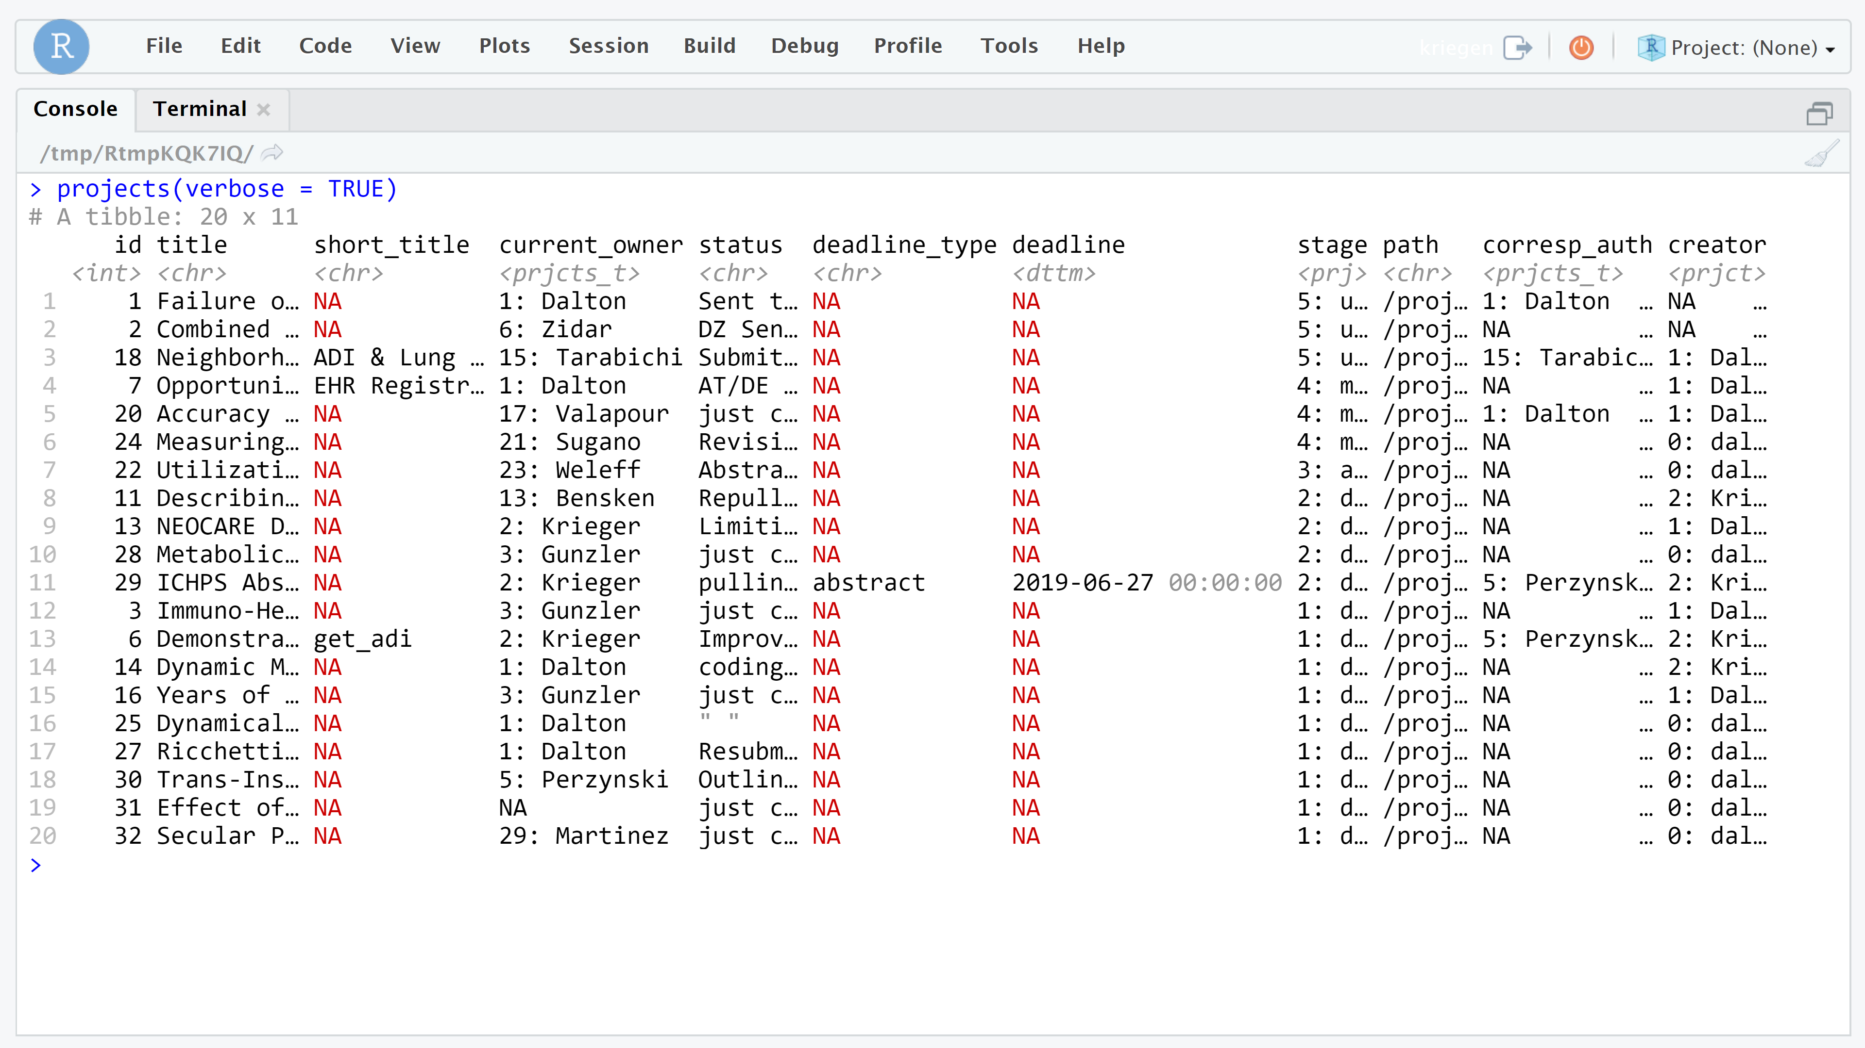

Slide 31
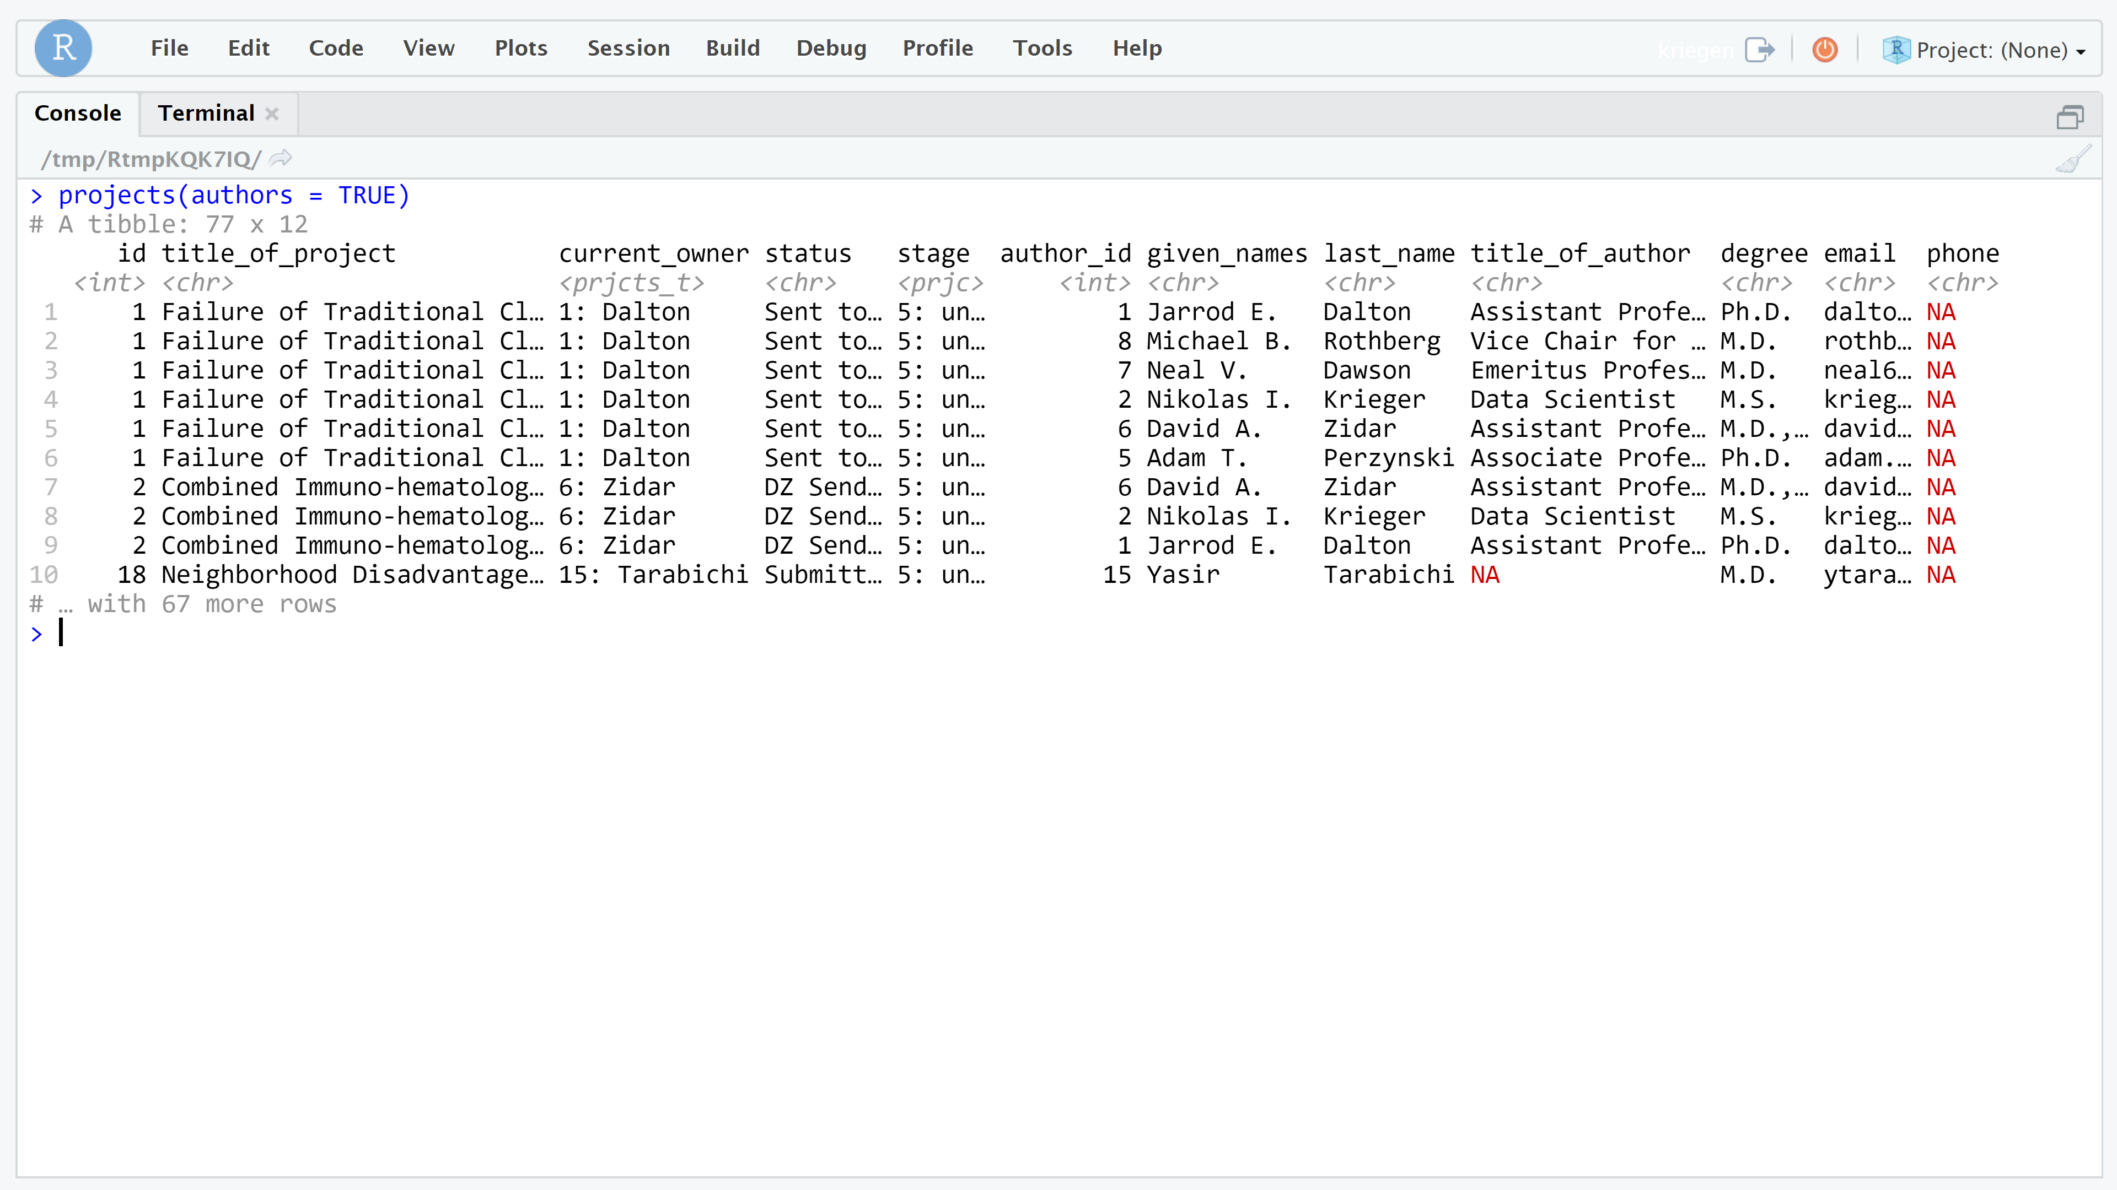

Slide 32
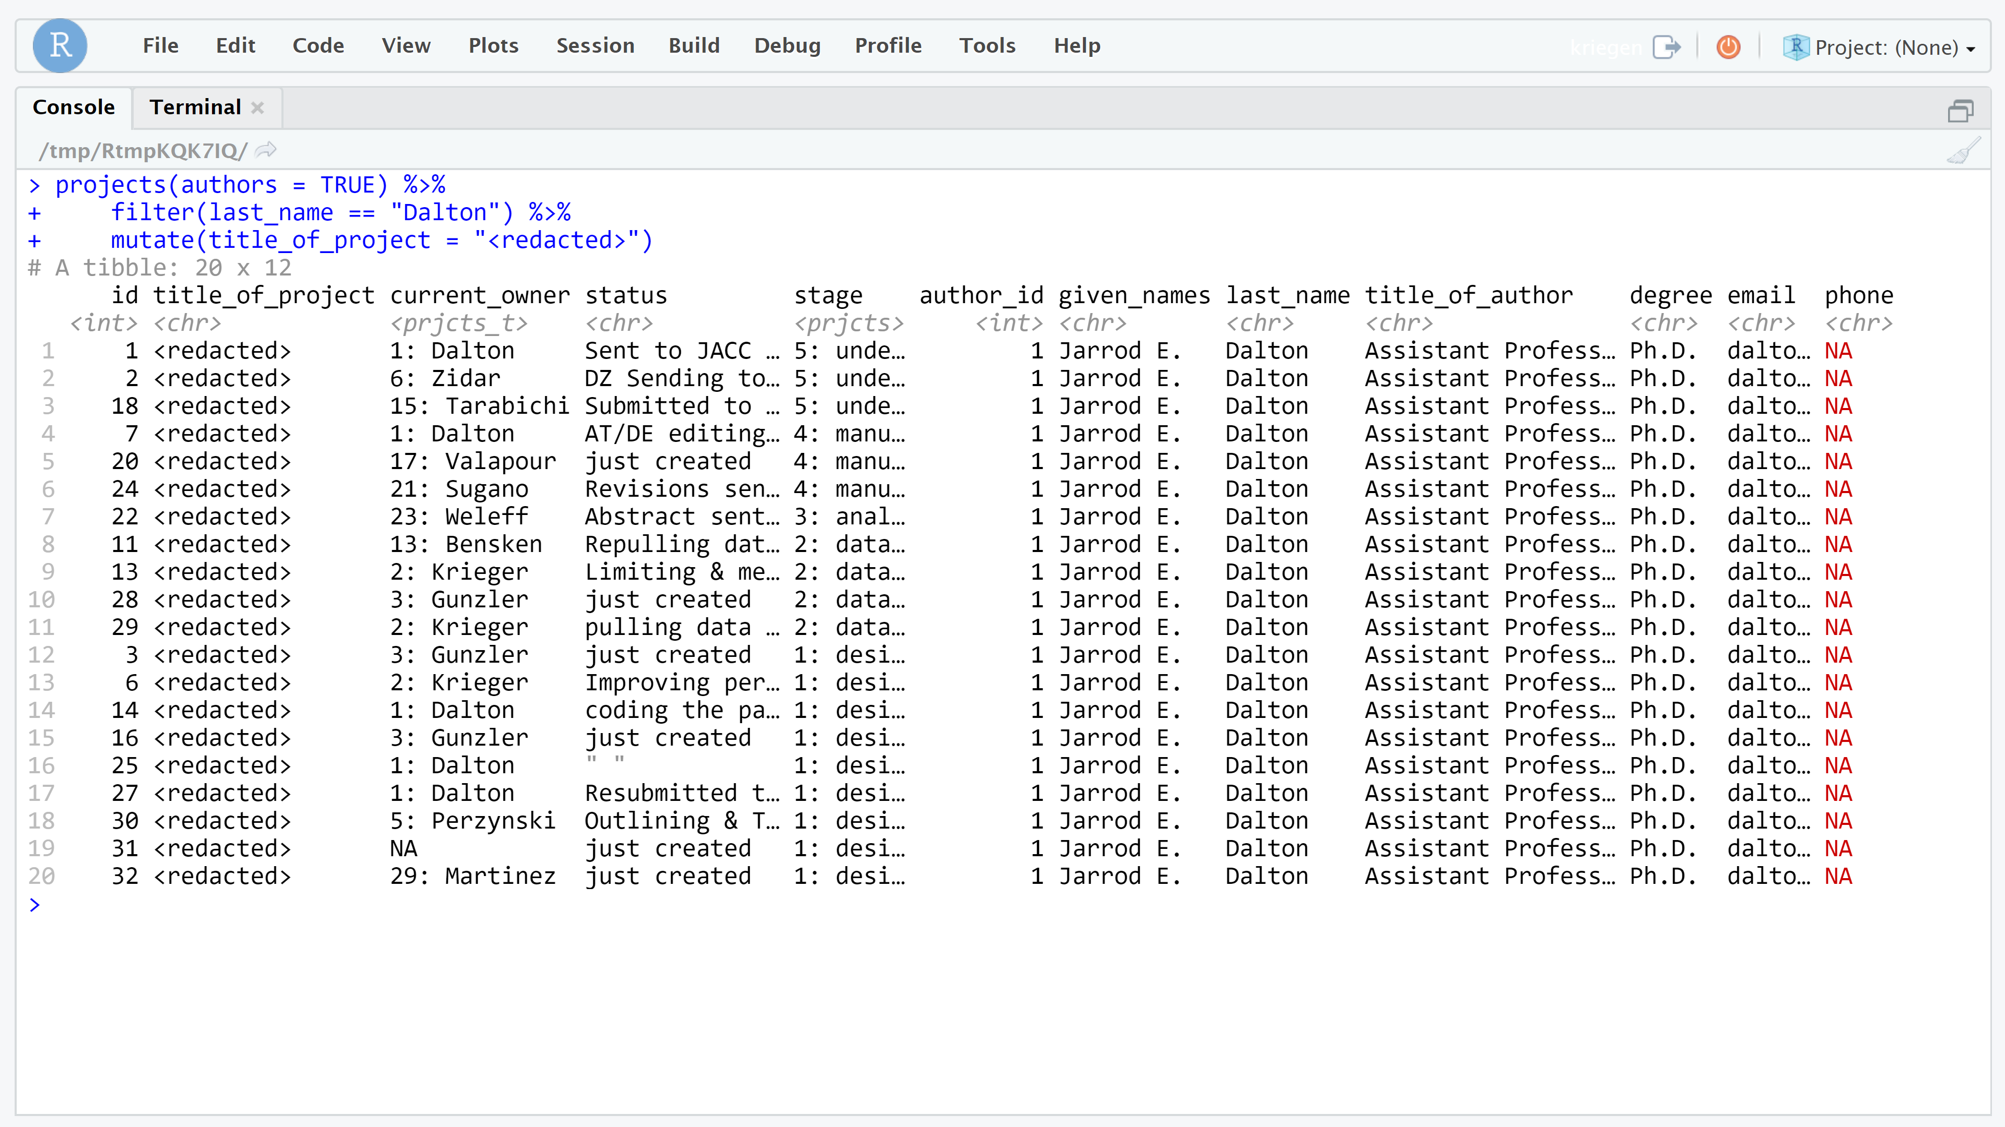

Slide 33
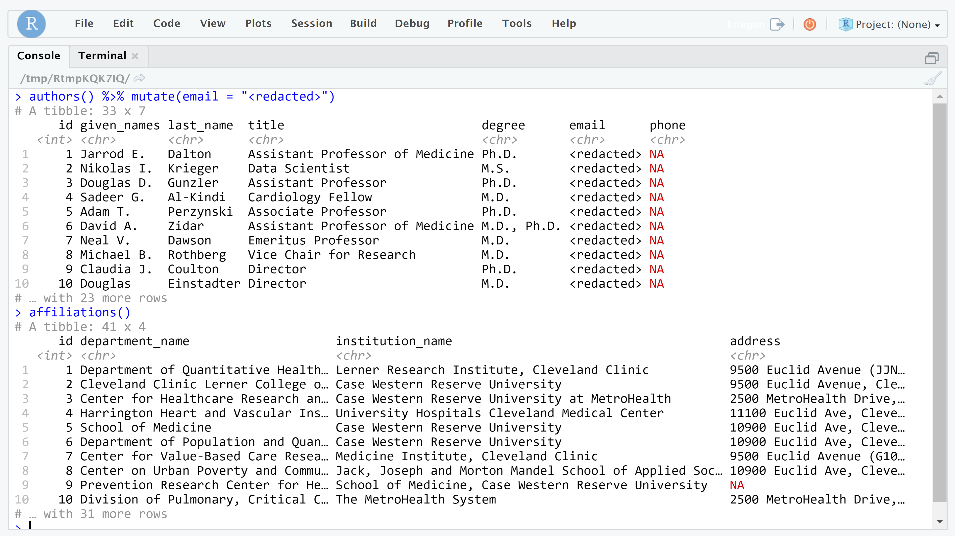

Slide 34
Other features:
save_session_info()
email_authors()
export_project()
open_project()

Slide 35
Funding: NIA R01AG055480 (Dalton and Perzynski)
github.com/NikKrieger/projects

